Slide 1


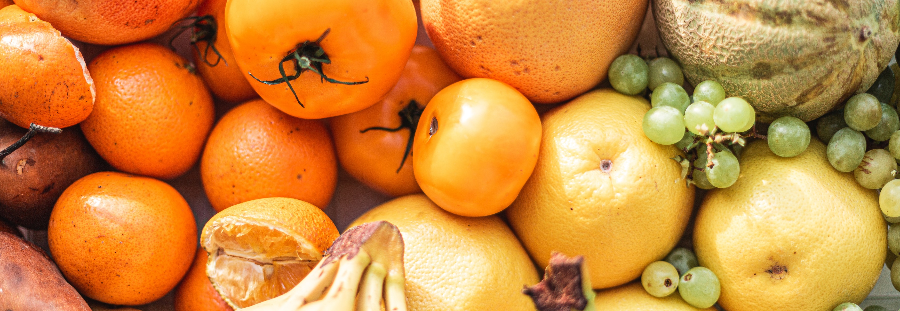
Jimmy Nyum Nyum
Search
Login
0
Cart
Browse Category
Chilled & Frozen
Beverages
Cookies & Snacks
Bakery
Health & Beauty
Fresh Fruits
Fresh Meat
Fresh Vegetables
Green Seafood
Organic Dry Fruit
Organic Juice
Sea & Fish
Summer Fruit
Baker’s Rock
Dairy & Cheese
Organic Wine
BIG SALE
GET UP TP 25% OFF
FREE SHIPPING
ON ORDERS OVER RM150
10% OFF
WHEN YOU USE CREDIT CARD

Slide 2

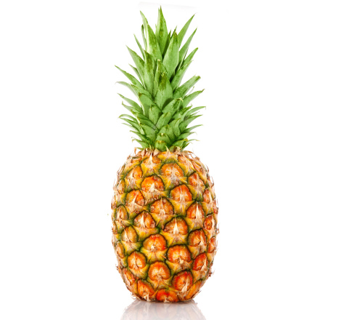
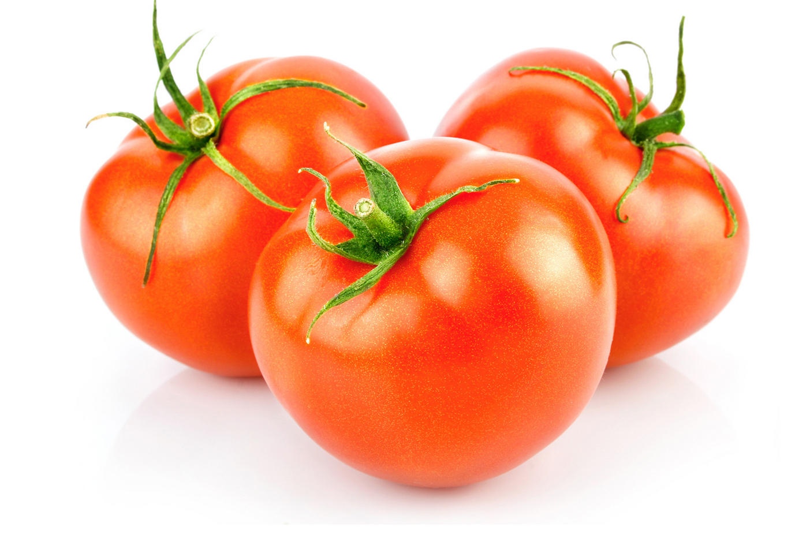
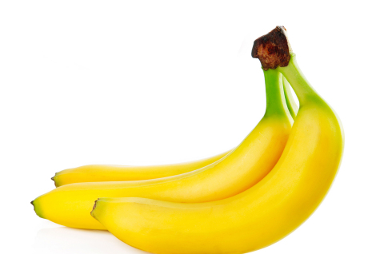
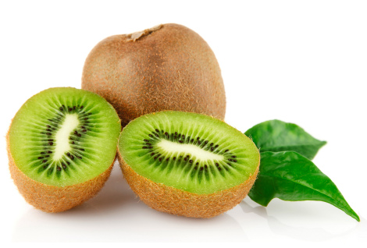
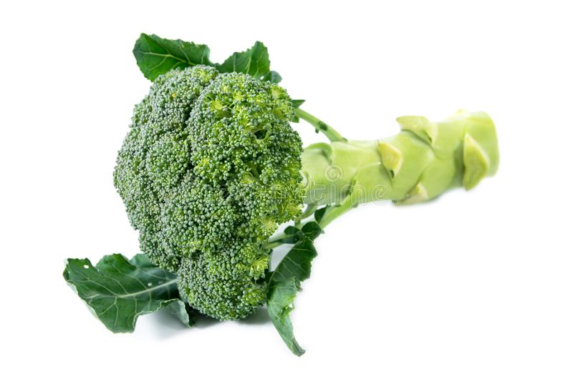
Jimmy Nyum Nyum
Search
Jimmy
5
Cart
Browse Category
Chilled & Frozen
Beverages
Cookies & Snacks
Bakery
Health & Beauty
Tomatoes
RM3.00/100g
Banana
RM3.00/100g
Pineapple
RM3.00/100g
Kiwis
RM3.00/100g
Brocolli
RM3.00/100g
Add to Cart
Add to Cart
Add to Cart
Add to Cart
Add to Cart
Tomatoes
RM3.00/100g
Tomatoes
RM3.00/100g
Tomatoes
RM3.00/100g
Tomatoes
RM3.00/100g
Tomatoes
RM3.00/100g
Add to Cart
Add to Cart
Add to Cart
Add to Cart
Add to Cart

Slide 3
Browse Category
Chilled & Frozen
Beverages
Cookies & Snacks
Bakery
Health & Beauty
Jimmy Nyum Nyum

